Slide 1
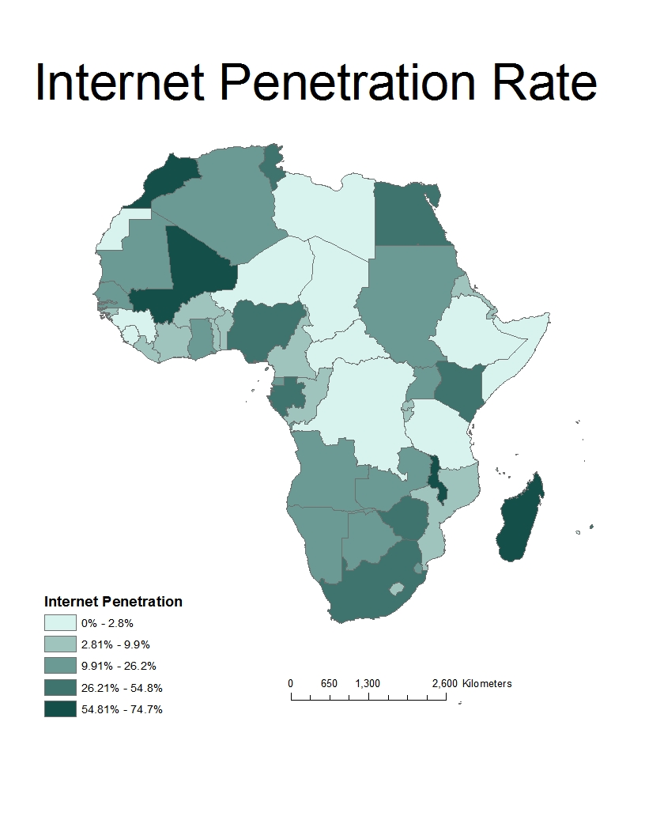
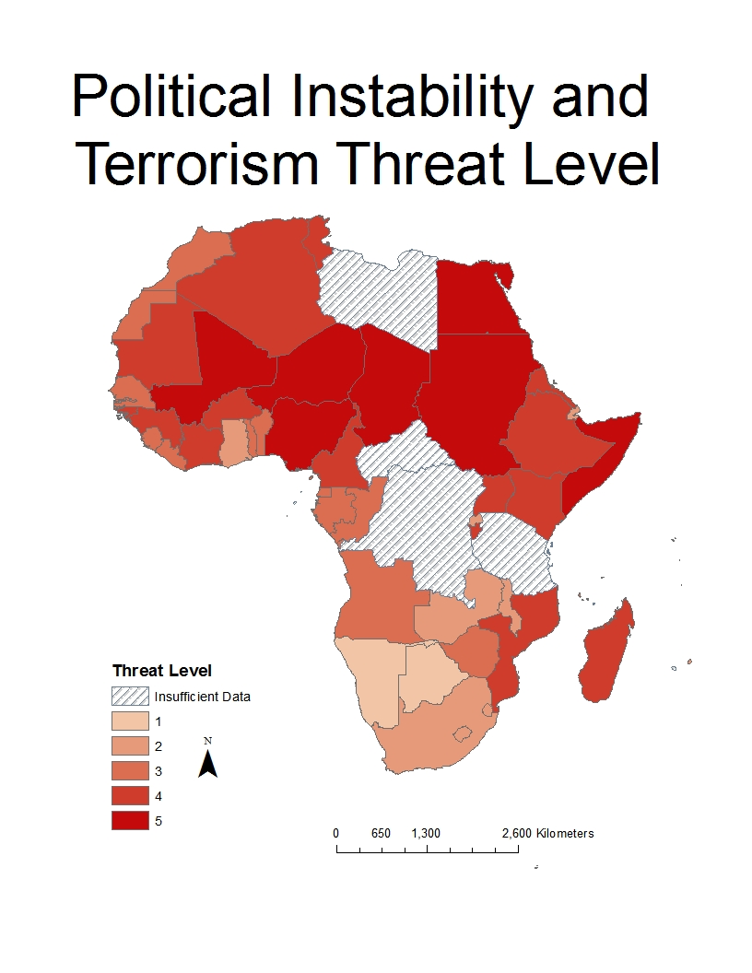
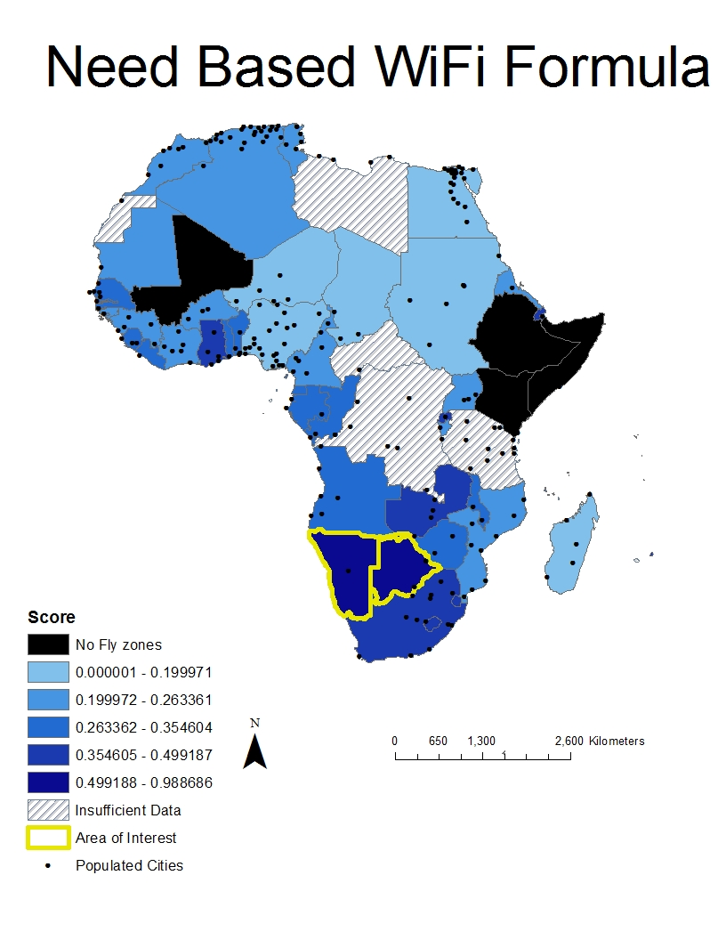
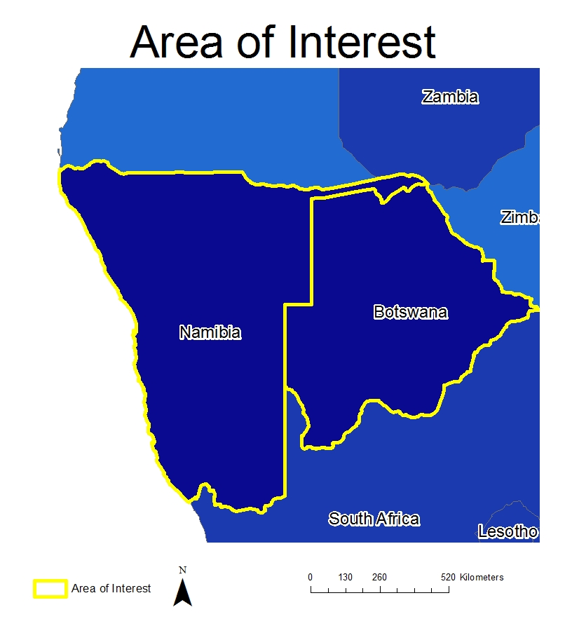
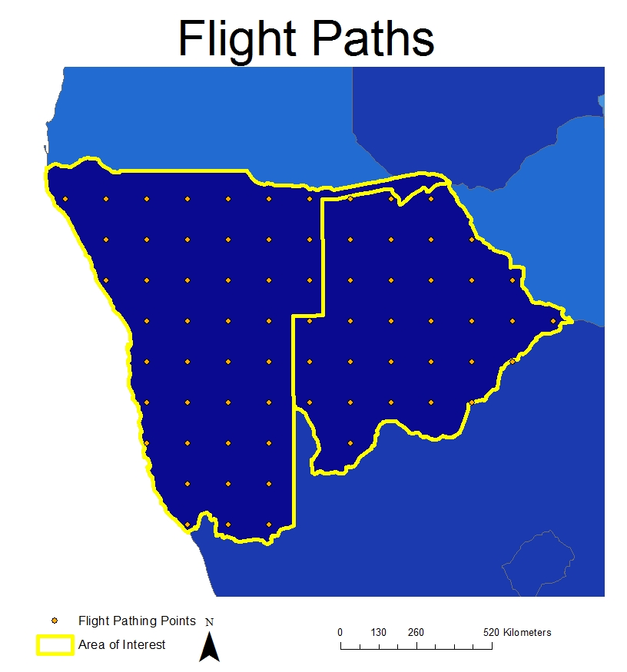
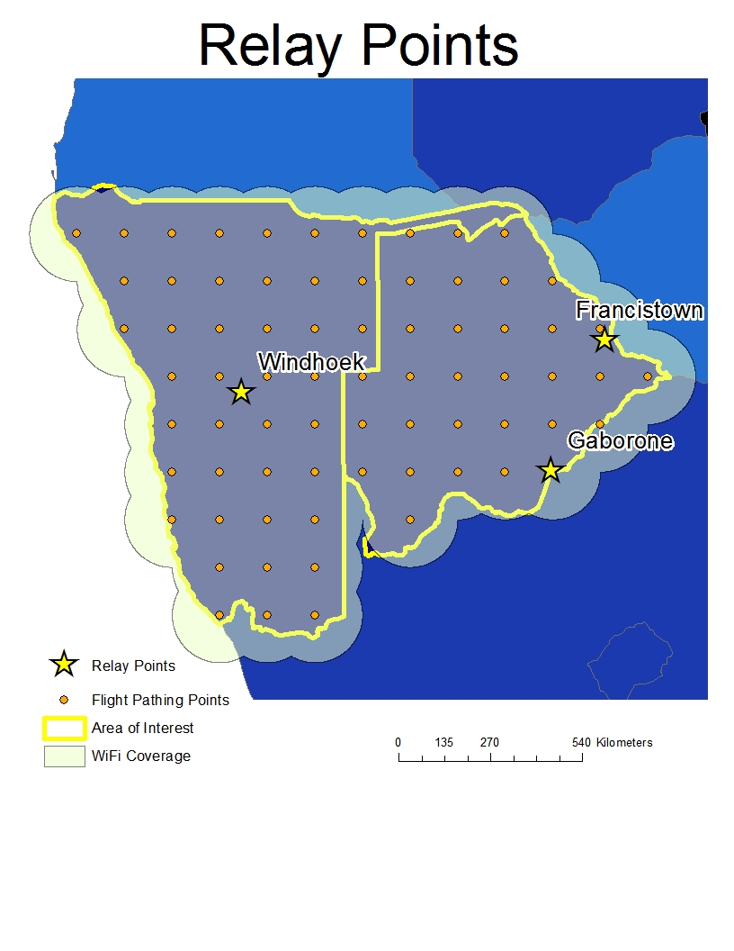
Providing Drone Based WiFi to Remote Areas of Africa
Abstract
Currently, the continent of Africa accounts for 15.7% of the world population, but only 9.8% of the world's internet population. In order to develop real economic infrastructure in the remote regions of the continent, digital infrastructure for communications must be established. To accomplish this task, aerial drones outfitted with WiFi emitting devices can be spread across areas of he continent creating a network of WiFi hotspots to provide widespread internet access to remote areas. The first step in the utilization of drones to provide WiFi access was to determine which areas needed additional networking support the most. However, as current political/regional affairs present risks to international aid groups and aerial vehicles, area threat levels must be taken into account. To fully account for this, population and percent population with internet access is weighed against the possibility of threat to the program. After determining which areas of the continent would receive the program, the next step was to determine flight paths for the emitters. Finally the effectiveness of the program is measured by a map displaying the potential WiFi coverage of the area. Although the scope of the program had to be decreased for initial testing, the end result was an effective communication grid utilizing the drones.
Additional Information
As creating communication for a 30 million square kilometer area is no easy task, options besides ground based networking need to be explored. Since many areas of the continent also provide risks such as political instability, terrorist cell operations, and corrupt government interference, the best course of action is to take the infrastructure to the clouds.
To create the communication systems needed across majorly underdeveloped land, low-atmosphere satellite drones provide a course of action with minimized risks.
The drone of choice is the Titan Solara 50, a low-atmosphere satellite. The Titan Solara 50 by Titan Aeronautics has a 20 kilometer altitude and a 4.54 million kilometer flight distance. This means that each drone is capable of flying for 5 year intervals above atmospheric weather conditions.
The WiFi emitter chosen to be utilized is a high-powered WiFi broadcaster with a 70 kilometer radial range. The emitter weighs only 20 lbs, well within the 70 lbs payload of the Titan Solara 50. In order to utilize these tools in providing WiFi access across remote areas of Africa, efficient flight paths must be outlined to provide the greatest amount of networking with the lowest amount of resources.
Scoring Formula
S = Score ranked 0.0-1.0, Lowest to Highest respectively
T = Political Instability Level ranked 1-5, Lowest to Highest respectively
P = Percentage of Population with Internet Access
F = Fly vs No Fly Zone, Represented as 0 or 1 respectively
Conclusion
Acknowledgements
Map Source: Ryan Dixon
Data Sources: Africa Shapefile- ESRI
1.African Internet User Statistics- Miniwatts Marketing Group
2.Terrorism Threat Level- AON
3.Titan Drone Data- Titan Aerospace
4.DARPA WiFi Emitter Data- DARPA
Projection: Africa Lambert Conformal Conic
To conclude, this study has outlined how a drone-based communication grid effectively provides infrastructure for expansive underdeveloped areas. While this type of program may not be ready to cover entire continents, it effectively provides a communication grid for areas of 1 million square kilometers. The flight paths outlined provide only one possibility as to how the drones can be patterned out to cover the area of interest. The paths outlined make use of 72 Titan Solara 50 drones each equipped with a DARPA High Powered WiFi Emitter. These paths the virtual entirety of the two countries' combined 1,424,662 square kilometer area.
Notes:
1

