Slide 1
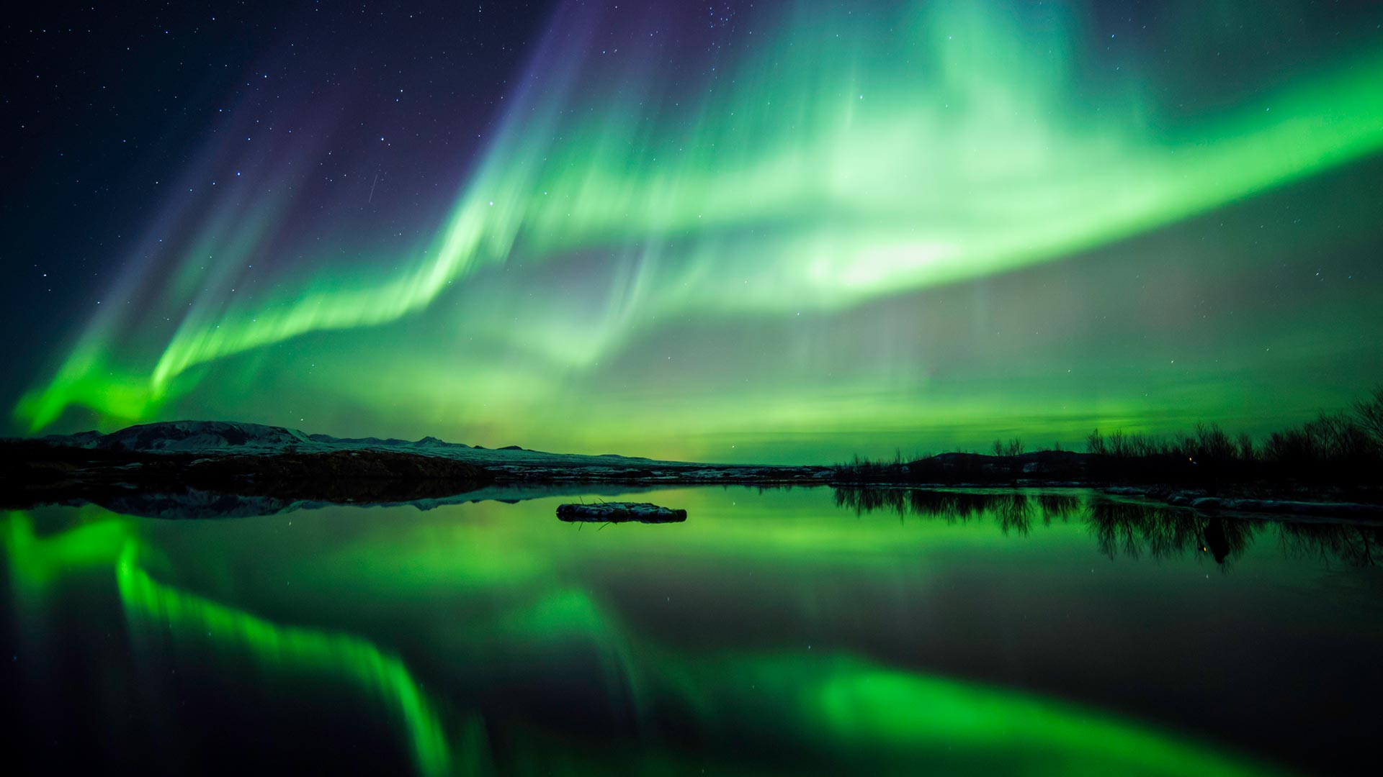
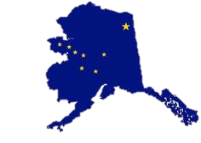
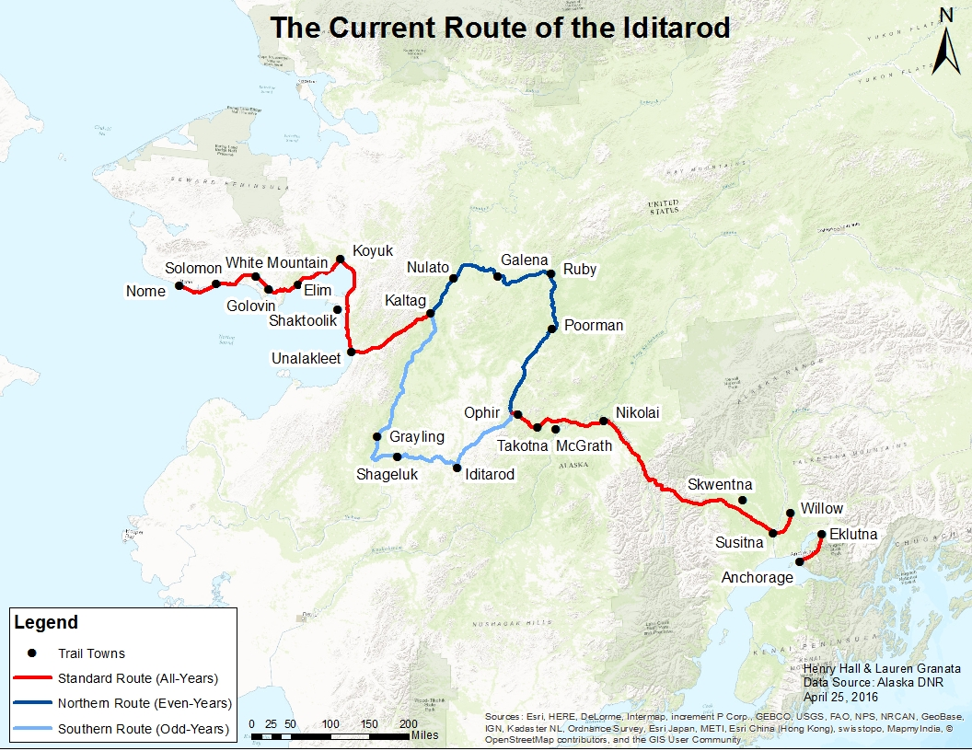
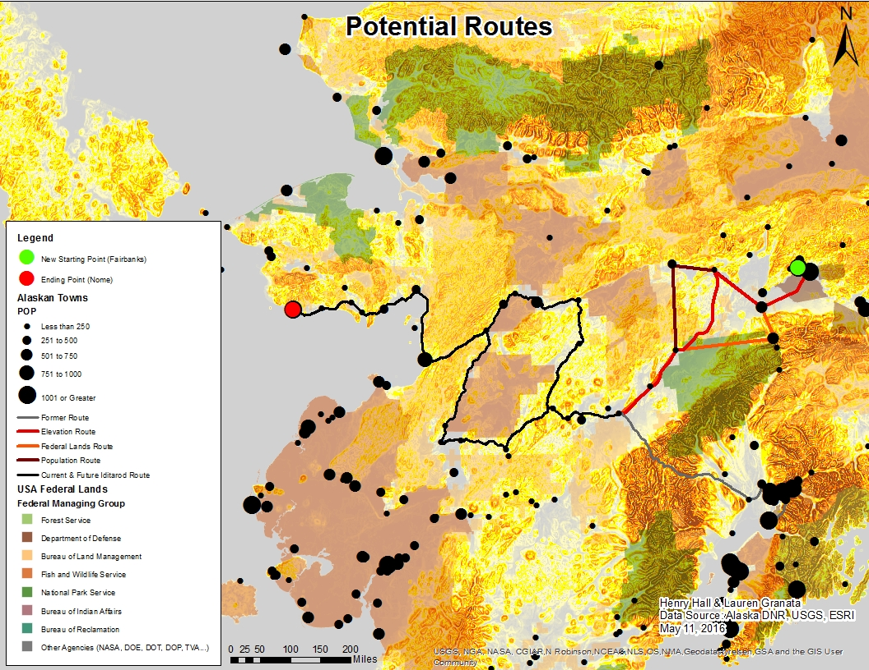
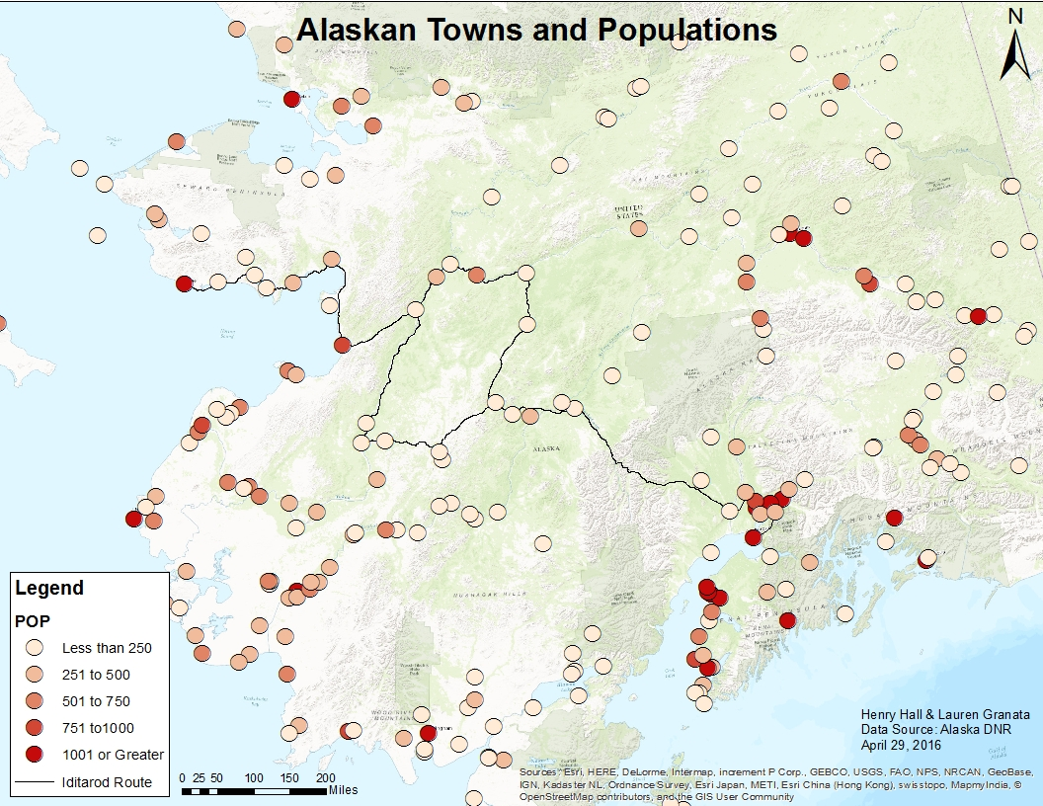
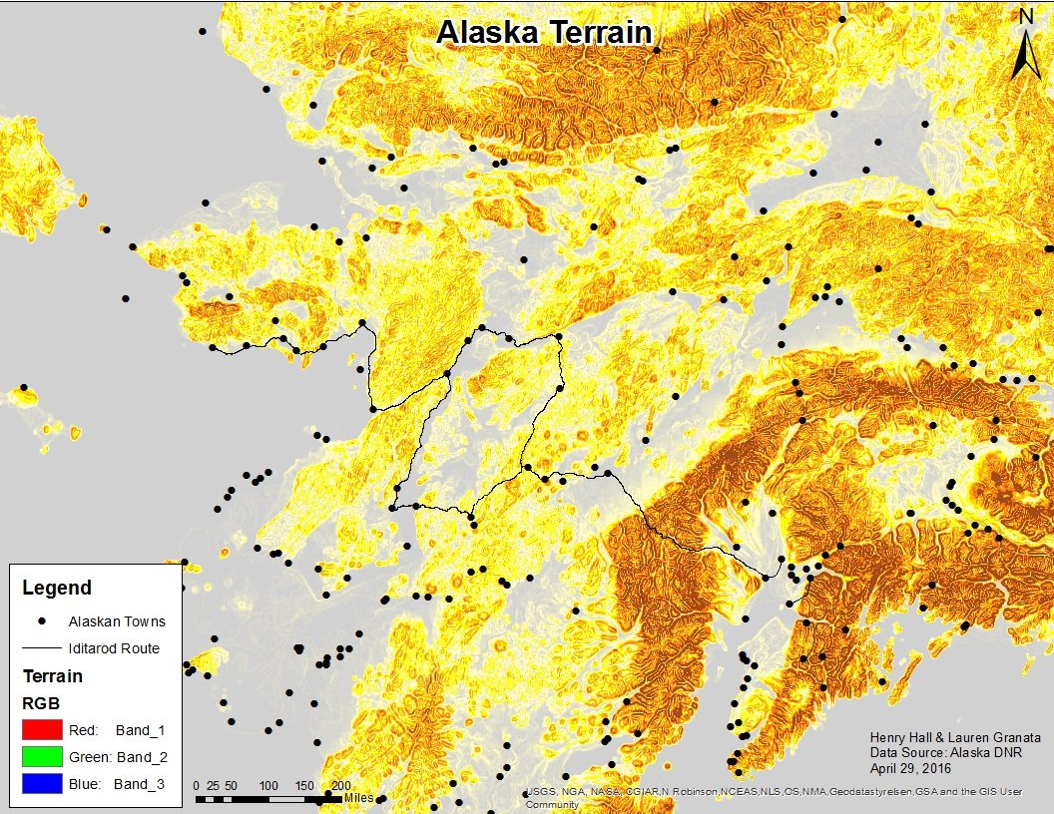
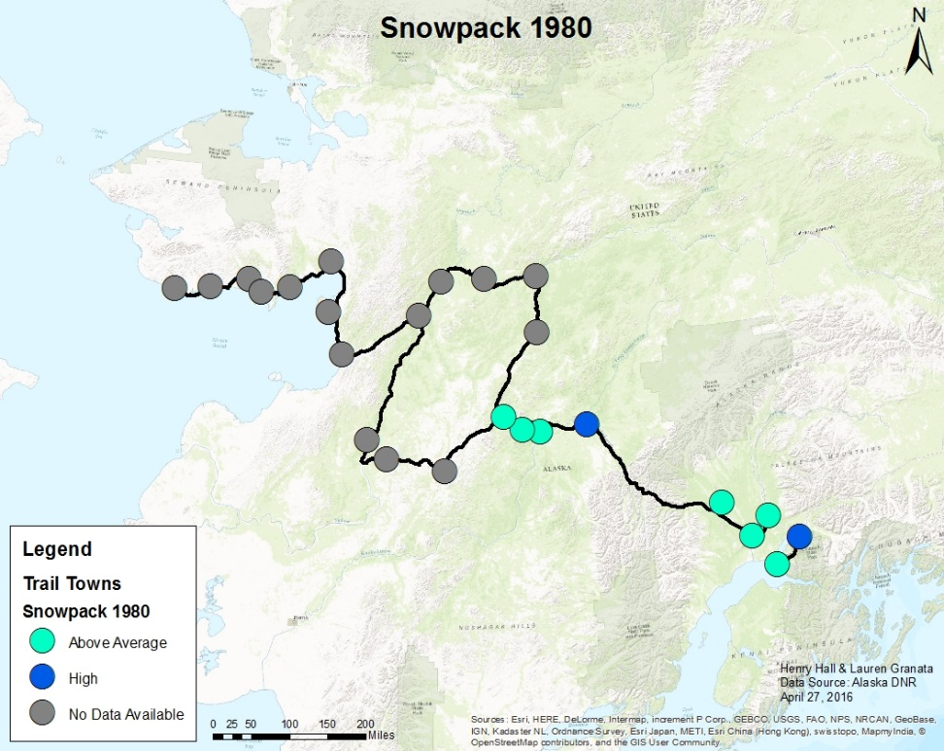
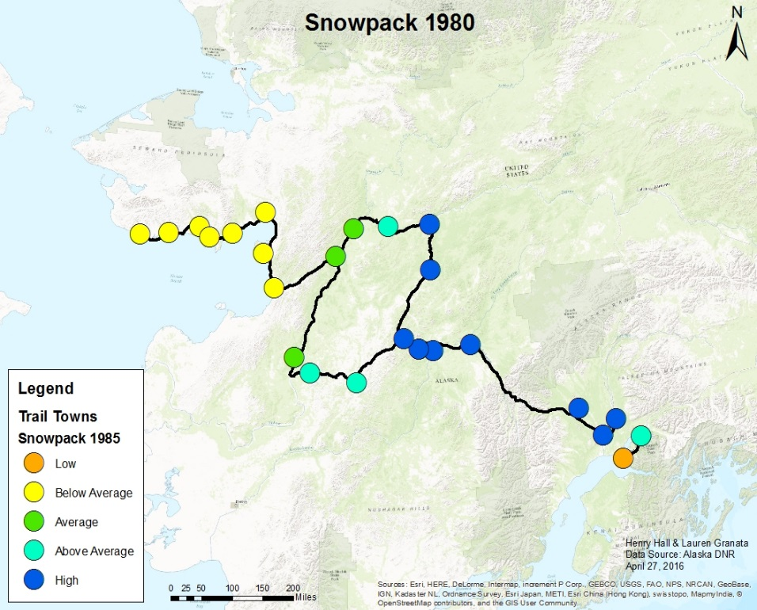
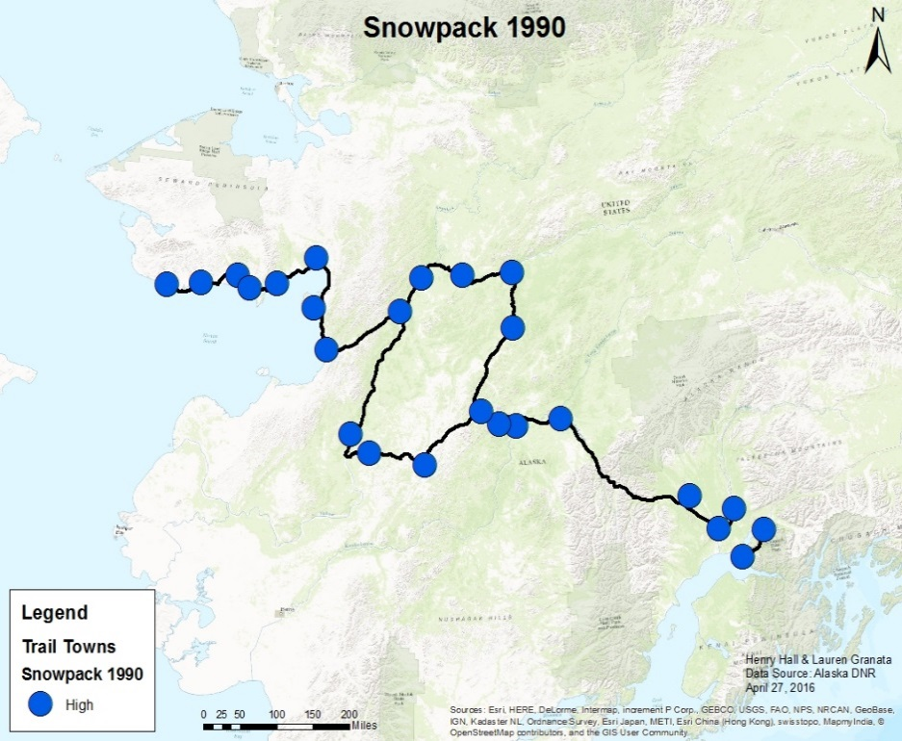
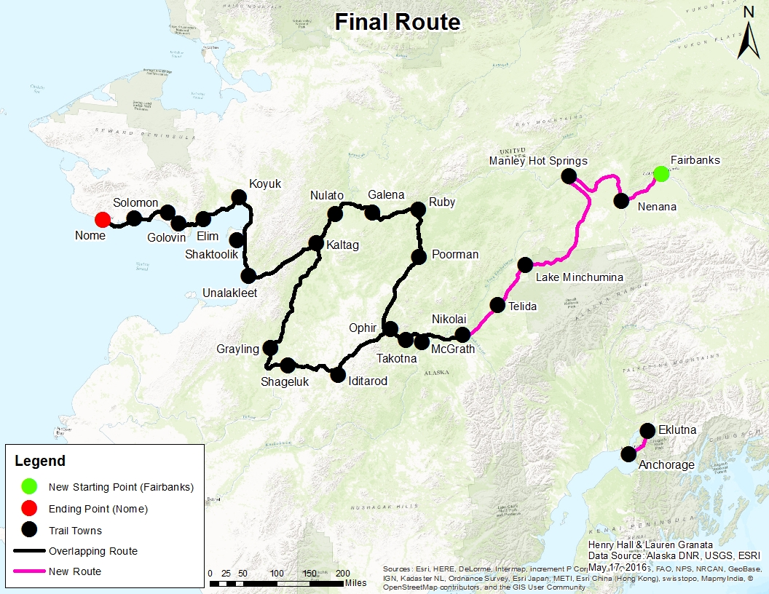
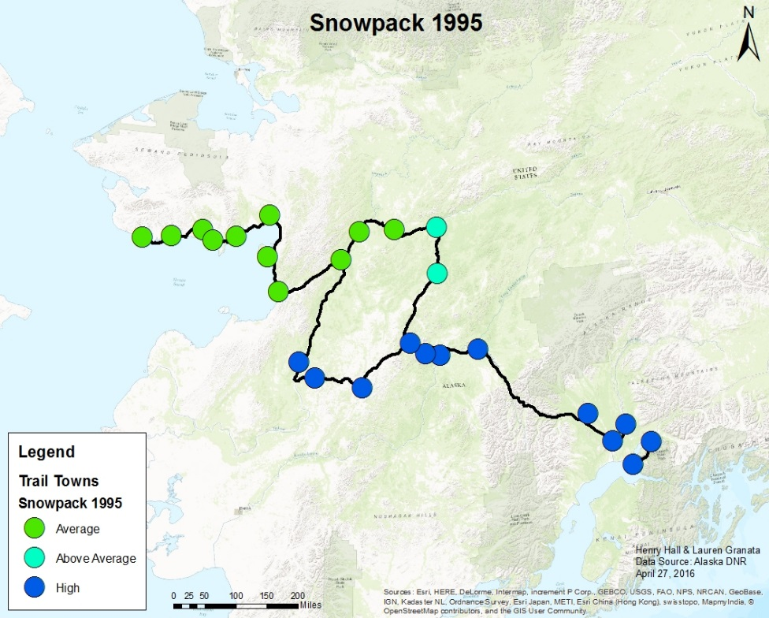
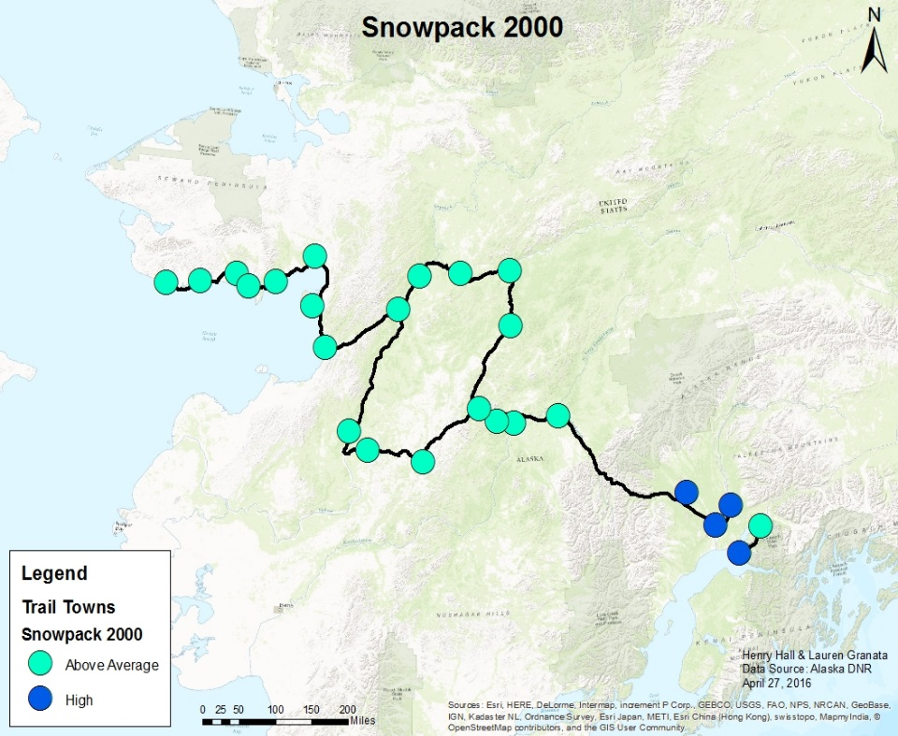
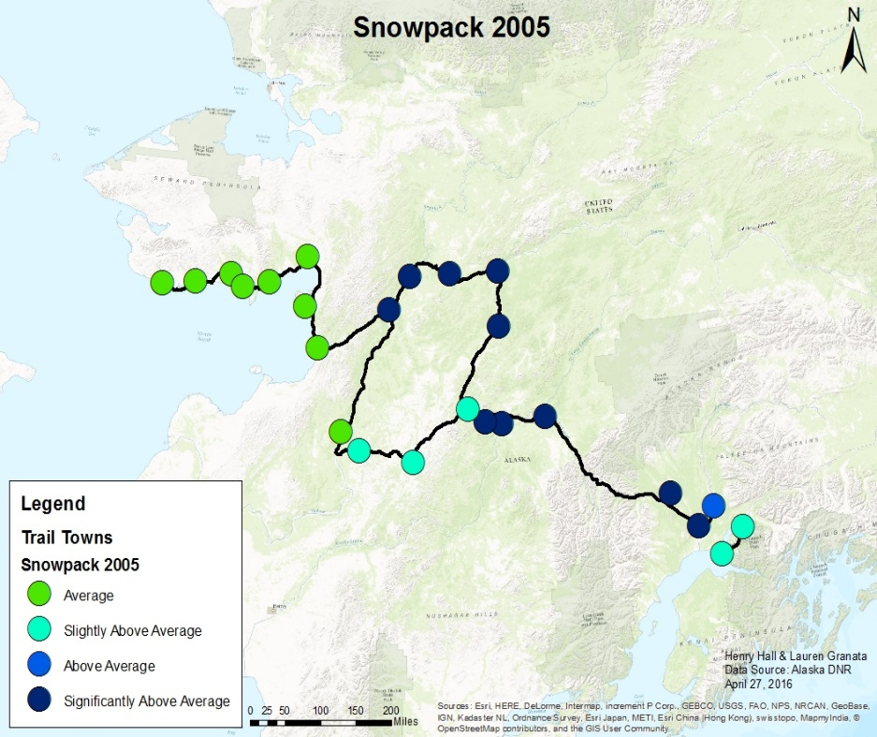
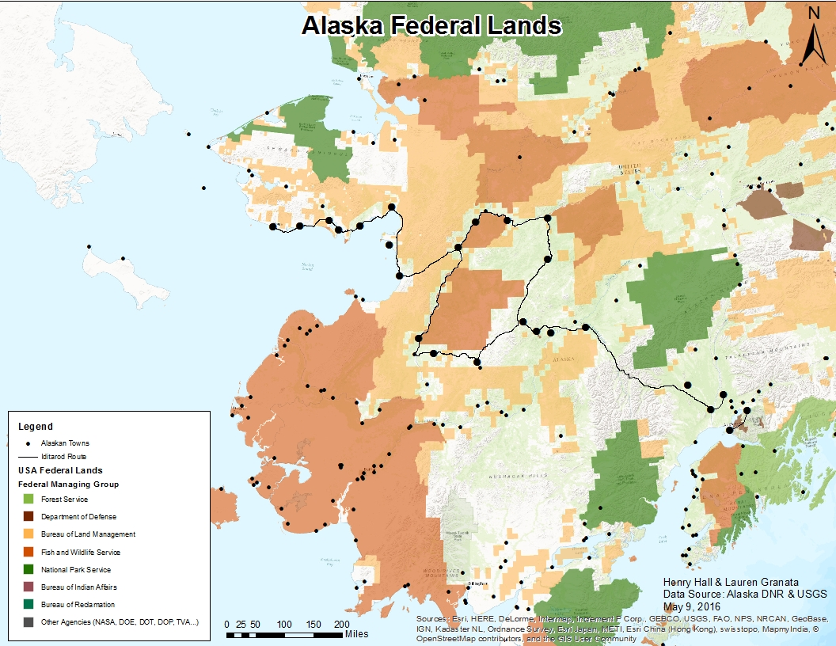
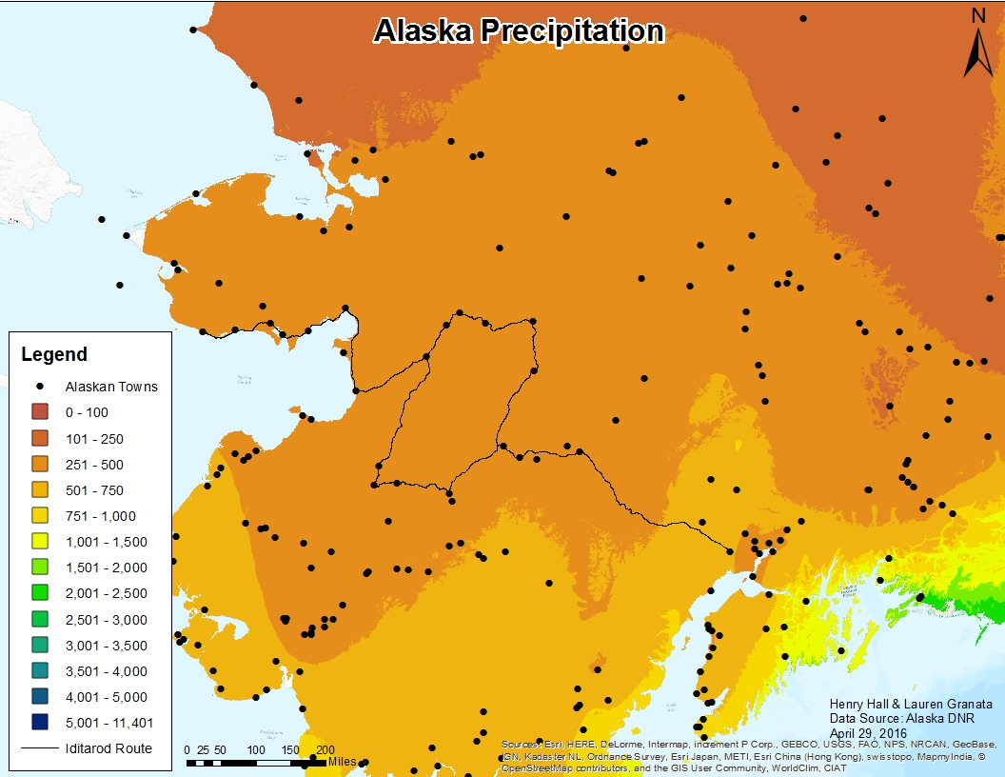
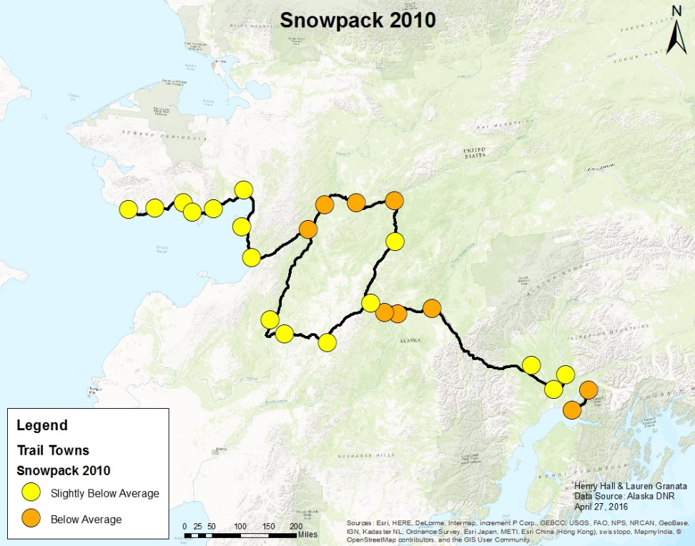
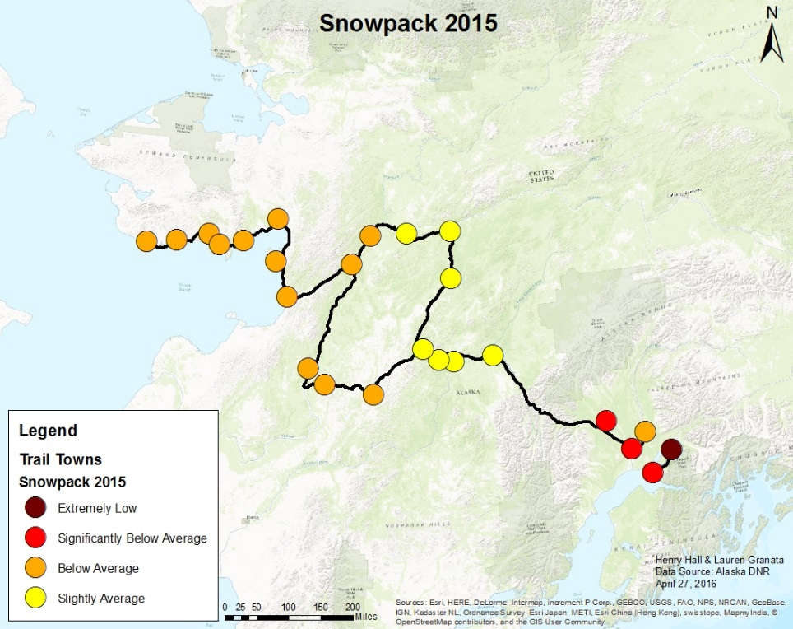
Rerouting the Iditarod
Henry Hall and Lauren Granata
Purpose:
The Iditarod is the most famous sled-dog race in the world. Since its modern-day establishment in 1973 the mushers have traversed the trail from Anchorage to Nome each March. However, due to climate change, snowpacks have been depleted causing major reroutes of the trail in 2003 and 2015. These reroutes fail to maintain the integrity of the race as the results are inconsistent from year to year. In order to keep the race truly fair and grand, it would be wise to reroute the trail permanently on a less vulnerable route that respects historical aspects and maintains the necessities of the great journey. A number of criteria must be met to ensure that this goal is accomplished in a reasonable manner.
Process of Analysis:
It was determined that the trail should start at Fairbanks, as it is the only sizable town in Alaska’s interior. It was also decided that the trail should rejoin at Nikolai to maintain a large portion of the original route. Between these points population, terrain, federal lands, and precipitation were used in order to determine the most appropriate route. With the exception of precipitation (which is the same throughout Central Alaska), a route was deciphered that best fit each the specifications individually (as seen below). These newly created routes were analyzed individually in order to determine which route best fit the specifications.
Individual Criteria
Snowpacks over 5-Year Intervals
1985
Recommended New Route
Solution:
By taking into account maintaining as much of the original trail as possible, ensuring similar length, heading northwards where the climate is more ideal, taking advantage of federal lands, avoiding rugged areas, and passing through villages necessary to resupply along the way the final routing was selected. It is recommended that a route be taken which continues the historic ceremonial start in Anchorage mirroring the 2016 start, before starting officially in the large-city of Fairbanks, after which the trail will travel through unique landscapes along current winter trails before rejoining the historical trail in Nikolai. The new trail has a length of 1021/1044 miles, compared to the current length of 975/998 miles (an addition of 146 miles). This route should be an appealing alternative to the historic, yet increasingly inconsistent current route. It is likely that this more northerly route will remain consistently snow-covered even with the rapidly changing climate.
Works Cited:
Mountain Snowpack Map - Alaska. (2016). Retrieved May 17, 2016, from http://www.wcc.nrcs.usda.gov/cgibin/ak_snow.pl?state=alaska
Alaska Department of Natural Resources. (1992). Retrieved May 17, 2016, from http://dnr.alaska.gov/
U.S. Geological Survey. (2016). Retrieved May 17, 2016, from https://www.usgs.gov/
ESRI. (2016). Retrieved May 17, 2016, from http://www.ESRI.com/

