Slide 1
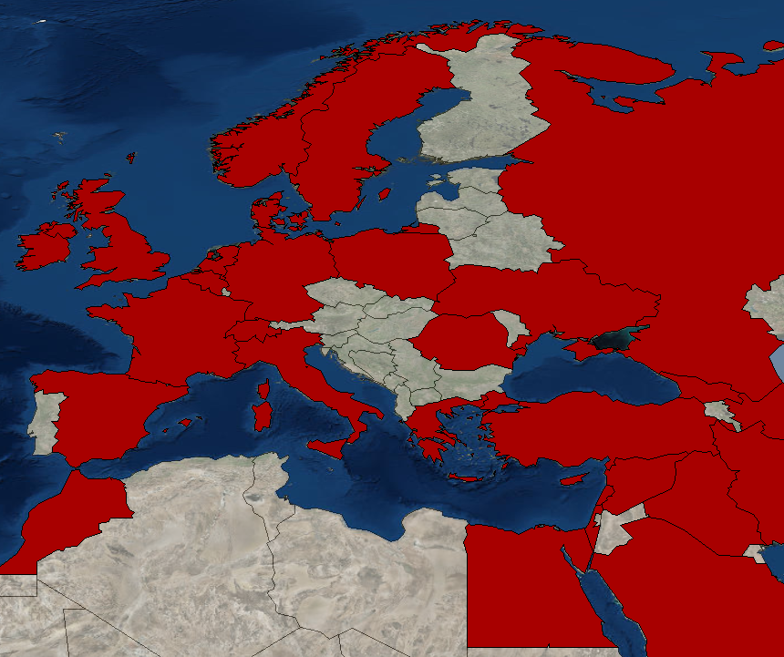
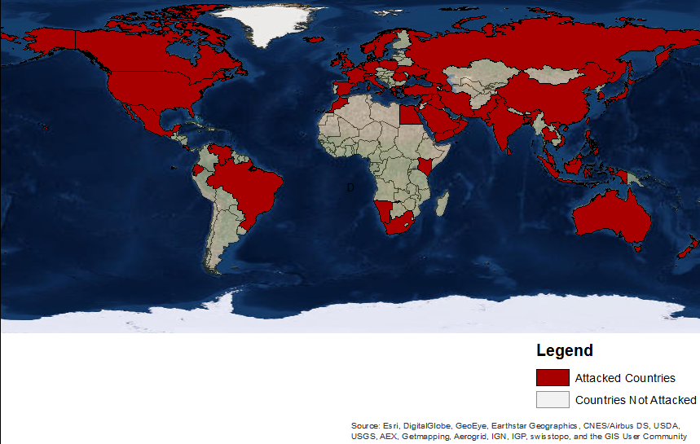
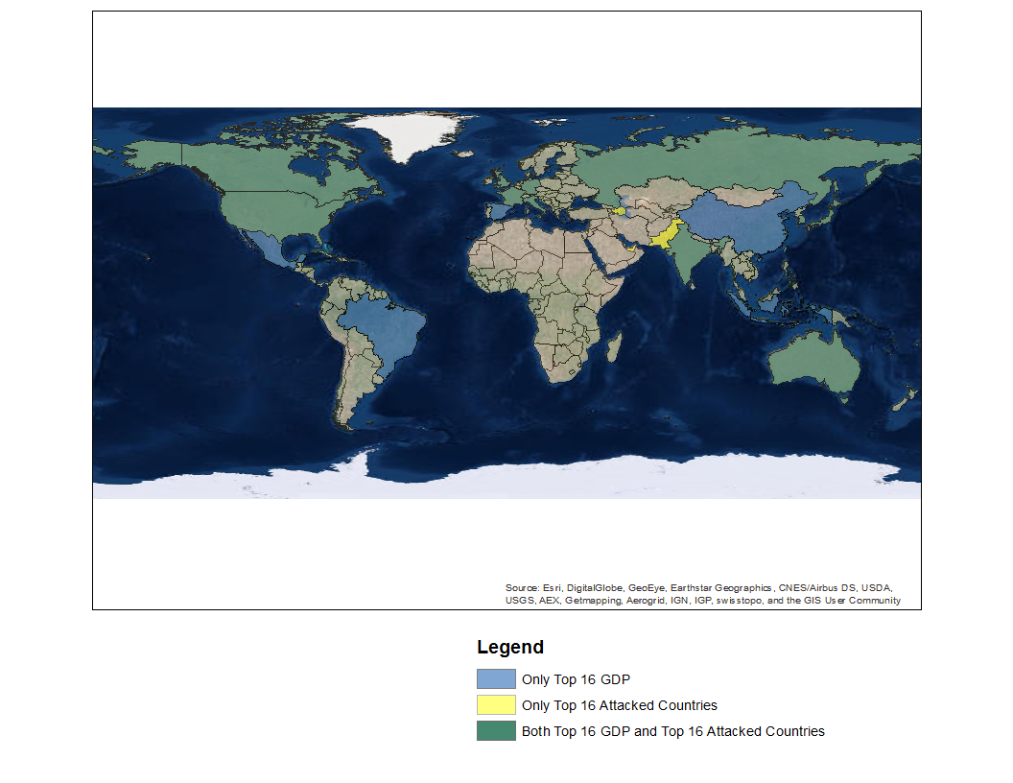
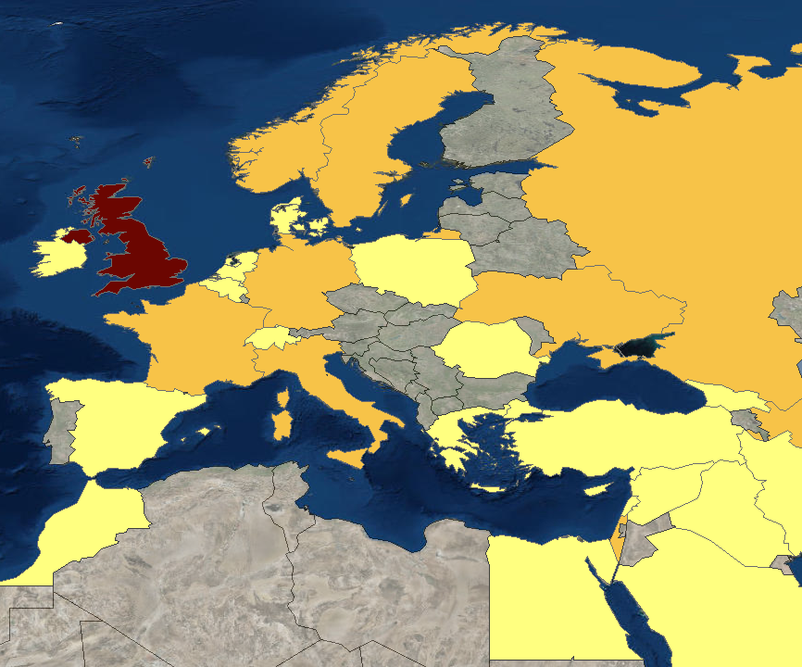
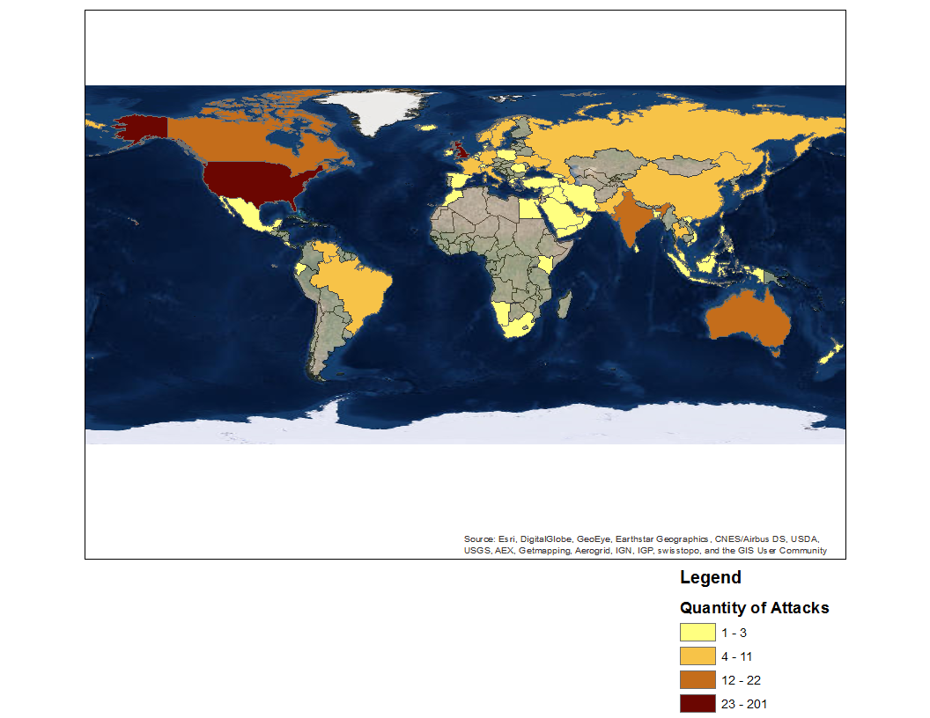
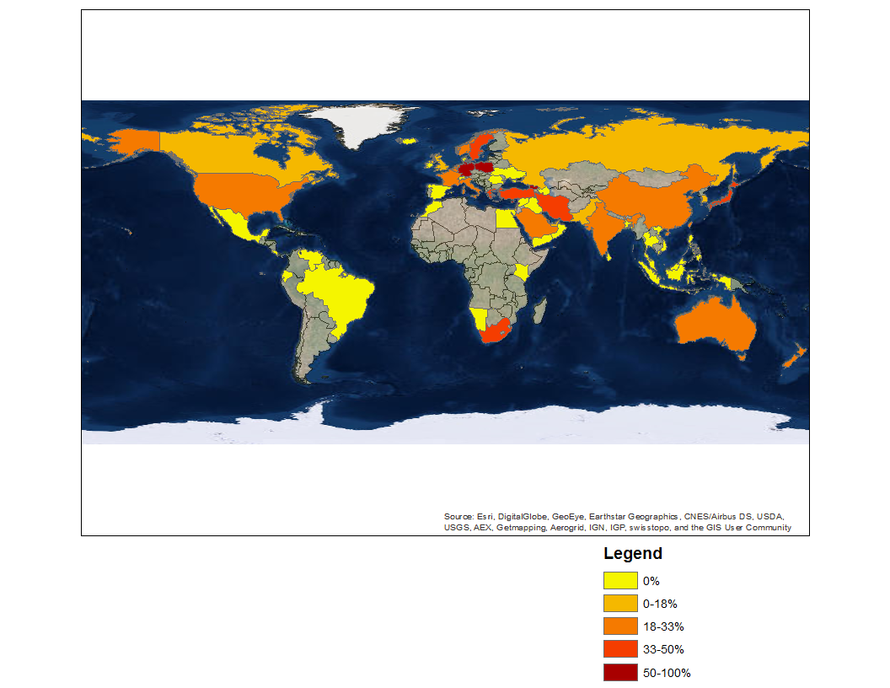
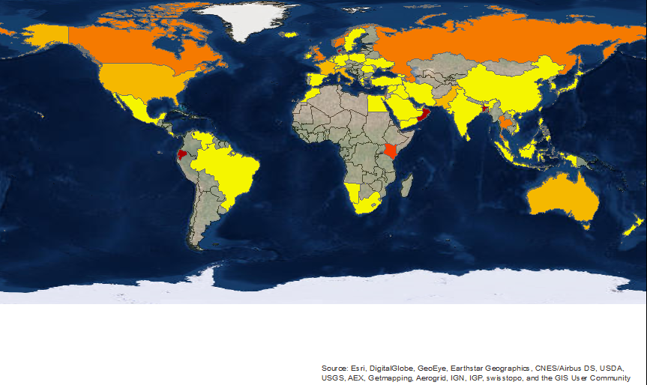
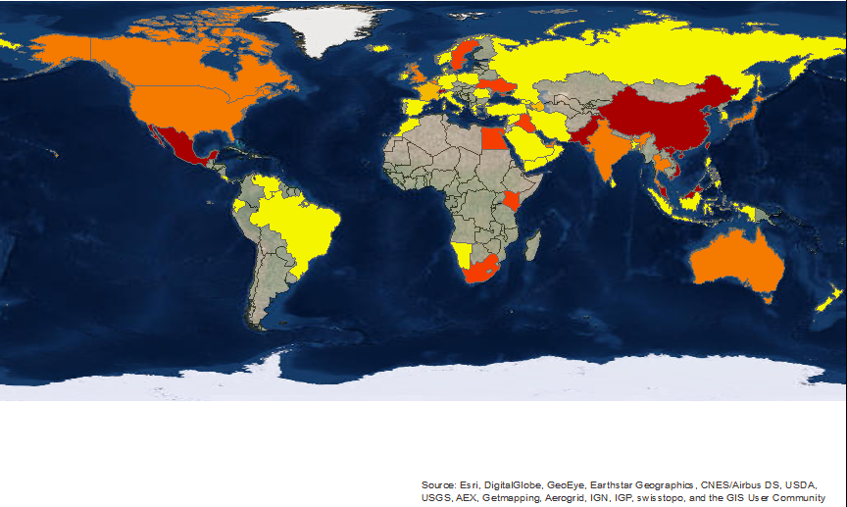
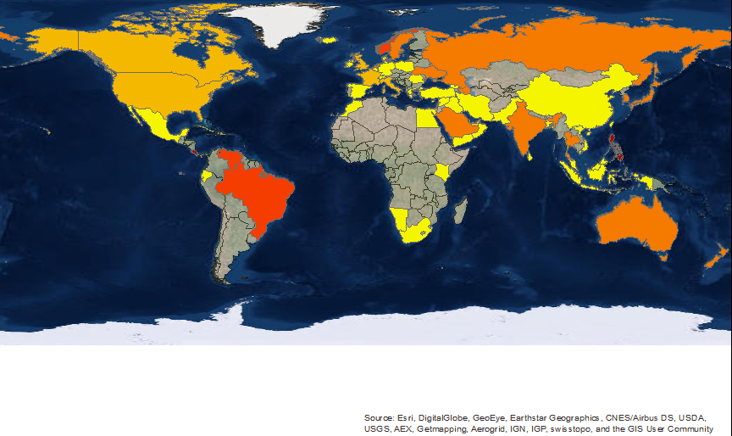
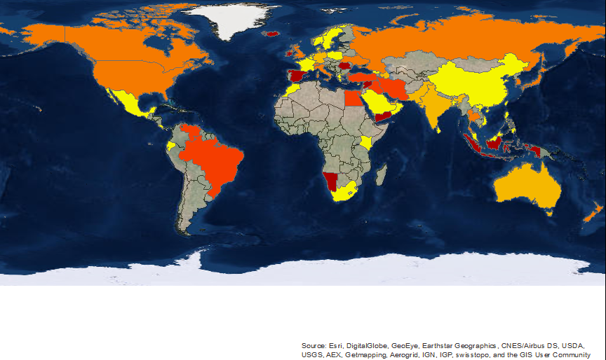
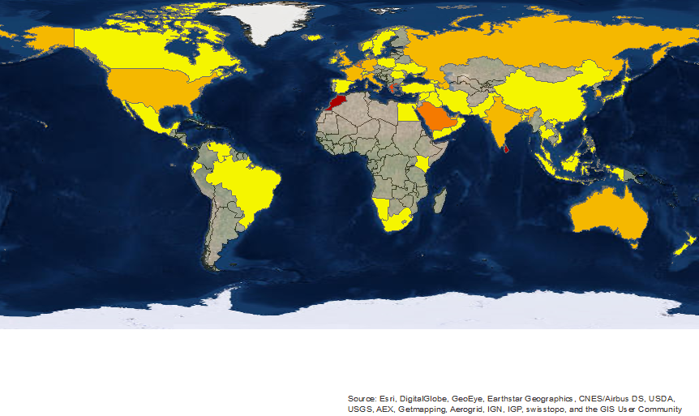
Cyber Crime
Created by: Fletcher Davis and Jason Rosenthal
Heritage High School
Sources: Hackmageddon.com, Worldbank.org, Esri.com
Introduction
A major concern in the 21st century is the threat of a cyber attack. The goal of this project was to discover which countries and their respective institutions are targeted the most. This information can later be used to determine which targets should strengthen their cyber security in order to prevent further attacks.
This map illustrates attacked countries vs. countries that have not been attacked, according to our data, which is minimal due to limited accessibility. Most of the attacked countries are developed nations, although there are some attacked developing countries.
This map shows the countries with the top 16 GDPs and top 16 most attacks, which are in green, just top 16 GDPs in blue, and just top 16 most attacks in yellow. Countries such as China and Brazil do not receive many attacks, but many attacks originate from there. Additionally, countries like Pakistan, Azerbaijan, UAE, and Israel receive many attacks because they are involved in many regional tensions.
Conclusion:
It is evident throughout our maps that cyber crime is an increasingly prominent threat to nations around the world. This goal of this project was to identify which countries and sectors needed improved cyber security; however, we would have more success reaching this goal with more accessible data. Our data was very limited due to restricted access to information. In the future, we would like to ask organizations and federal agencies such as, Norse, NSA, and the FBI, in order to attain a larger quantity of data.
These six maps shows the percent of attacks per target class. Some observations are that Europe receives a majority of commerce attacks, which could be from their large economic influence. Also, the Middle East receives many government attacks, which is because of the volatile events currently transpiring there. China, Japan, and similar countries receive many technology attacks because they are heavily engaged in the technological center. Lastly, countries such as the U.S. and U.K. receive a similar number attacks across all sectors, which shows that they need to reinforce security in all sectors.
This map shows the quantity of attacks per country. The countries that are attacked the most generally are most advanced countries technologically.
Services
Government
Single Individual
Commerce
Recreation
Technology

